Slide 1
Client Side Scripting
Objects in JavaScript

Slide 2
Objects
Objects group together a set of variables and functions to create a model of something you would recognise from the real world
In an object, variables and functions take a new name
Variables are referred to as properties
Functions are referred to as methods

Slide 3
Properties
If a variable is part of an object, it is referred to as a property
Properties describe the object
For example, if we have a hotel object, properties can describe the name and number of rooms it has

Slide 4
Methods
If a function is part of an object, it is referred to as a method
Methods represent tasks which are associated with an object
For example, the number of available rooms can be found by subtracting the booked rooms from the total number of rooms

Slide 5
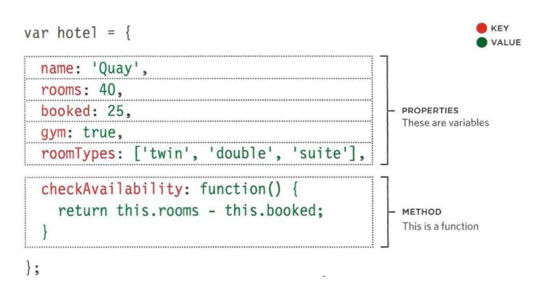
Creating Objects Literal Notation
This technique of creating an object is referred to as the Literal Notation
It is the easiest and most popular way of how objects are created
If you had two hotel objects on the same page, you would create each one using the same notation but store them in variables with different names

Slide 6
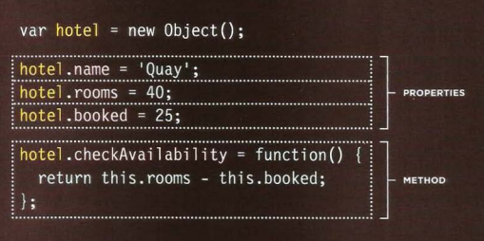
Creating Objects Constructor Notation
The new keyword and the object constructor create a blank object
You can then add properties and methods to the object

Slide 7
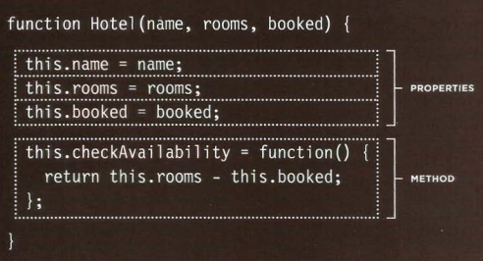
Creating Many Objects Constructor Notation
Sometimes several objects need to represent similar things
Object constructors can use a function as a template for creating objects
First the template is created with the object’s properties and methods
The this keyword is used instead of the object name to indicate that the property or method belongs to the object that this function creates
NB. Each statement that creates a new property or method for this object ends in a semicolon (not a comma, which is used in the literal notation)

Slide 8
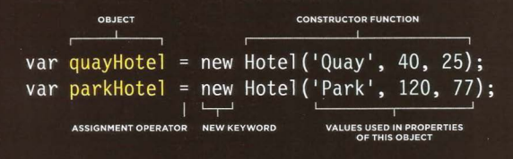
Creating Object Instances
The name of a constructor function usually begins with a capital letter to help developers remember that the new keyword is required
Object instances are created using the constructor function
Arguments are different for different instances since they represent the values of their properties

Slide 9
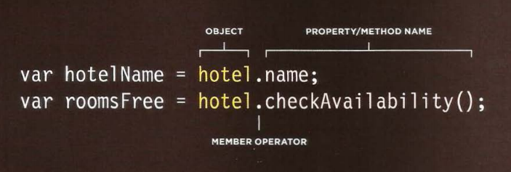
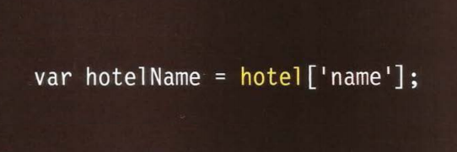
Accessing Objects
There are two ways how we can access properties and methods from an object:
Dot Notation
Square Brackets

Slide 10
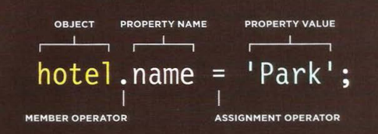
Updating Objects
To update a value, the same notation used to create a property/function can be used:
If such a property/function did not exist in that object, a new one would be created
Otherwise, the value would be updated accordingly

Slide 11


Deleting Objects
To delete a property/function completley, the delete keyword needs to be used:
If the value only needs to be cleared, this technique can be used:

Slide 12

Practice
Access Moodle and work out Worksheet 11

Slide 13
References
Johnson, G. (2013). Programming in HTML5 with Javascript and CSS3. United States of America: Microsoft Press.
McPeak, J. (2015). Beginning JavaScript, 5th Edition (5 ed.). Wrox.
Haverbeke, M. (2011). Eloquent JavaScript: A Modern Introduction to Programming. (S. Yang, Ed.) San Francisco: William Pollock.
McFarland, D. S. (2014). JavaScript & jQuery (3 ed.). United States of America: O’Reilly Media, Inc.
Duckett, J. (2014). JavaScript and JQuery Interactive Front-End Web Development (1 ed.). Wiley.
www.jquery.com

